Slide 1
HOUSEHOLD ELECTRICITY CONSUMPTION FORECASTING
By Anto Charles V

Slide 2
Problem Statement
Households across India face significant challenges in managing and predicting their monthly electricity consumption. Many families struggle with unpredictable electricity bills that arrive without warning, making it difficult to budget effectively. There is no mechanism for households to estimate their energy costs based on their appliance inventory and usage patterns. Additionally, users are unaware of how their appliances collectively affect voltage stability in their homes, which can potentially damage sensitive electronics over time.
The lack of appliance-level insights prevents consumers from understanding which devices consume the most electricity and what the actual cost of adding a new appliance would be. Without real-time insights and data-driven recommendations, users cannot optimize their energy consumption or make informed decisions about purchasing new appliances. This project addresses these critical gaps by developing SmartBill, a machine learning-powered system that instantly predicts electricity bills and voltage stability based on household characteristics and appliance inventory.

Slide 3
Proposed Solution
Machine Learning model using Random Forest Regressor
• Input: Appliance details (fans, lights, AC, geyser, washing machine, etc.)
• Input: Household info (family size, house size in sqft, number of rooms)
• Output: Predicted voltage (V) and monthly electricity bill (K)
• Streamlit web app for easy user access and real-time predictions
• SQLite database for secure user authentication and data management

Slide 4
Dataset Characteristics
Data Size
10,000 synthetic household records
Features
11 input variables (appliances + household)
Targets
Voltage (V) & Electricity Bill (K)

Slide 5
System Architecture
• Frontend: Streamlit web application (localhost:8501)
• Backend: Python with scikit-learn for ML models
• Database: SQLite for user authentication and management
• Models: Pre-trained Random Forest (saved as .pkl files)
• Deployment: Local server
• Libraries: pandas, numpy, joblib, streamlit

Slide 6
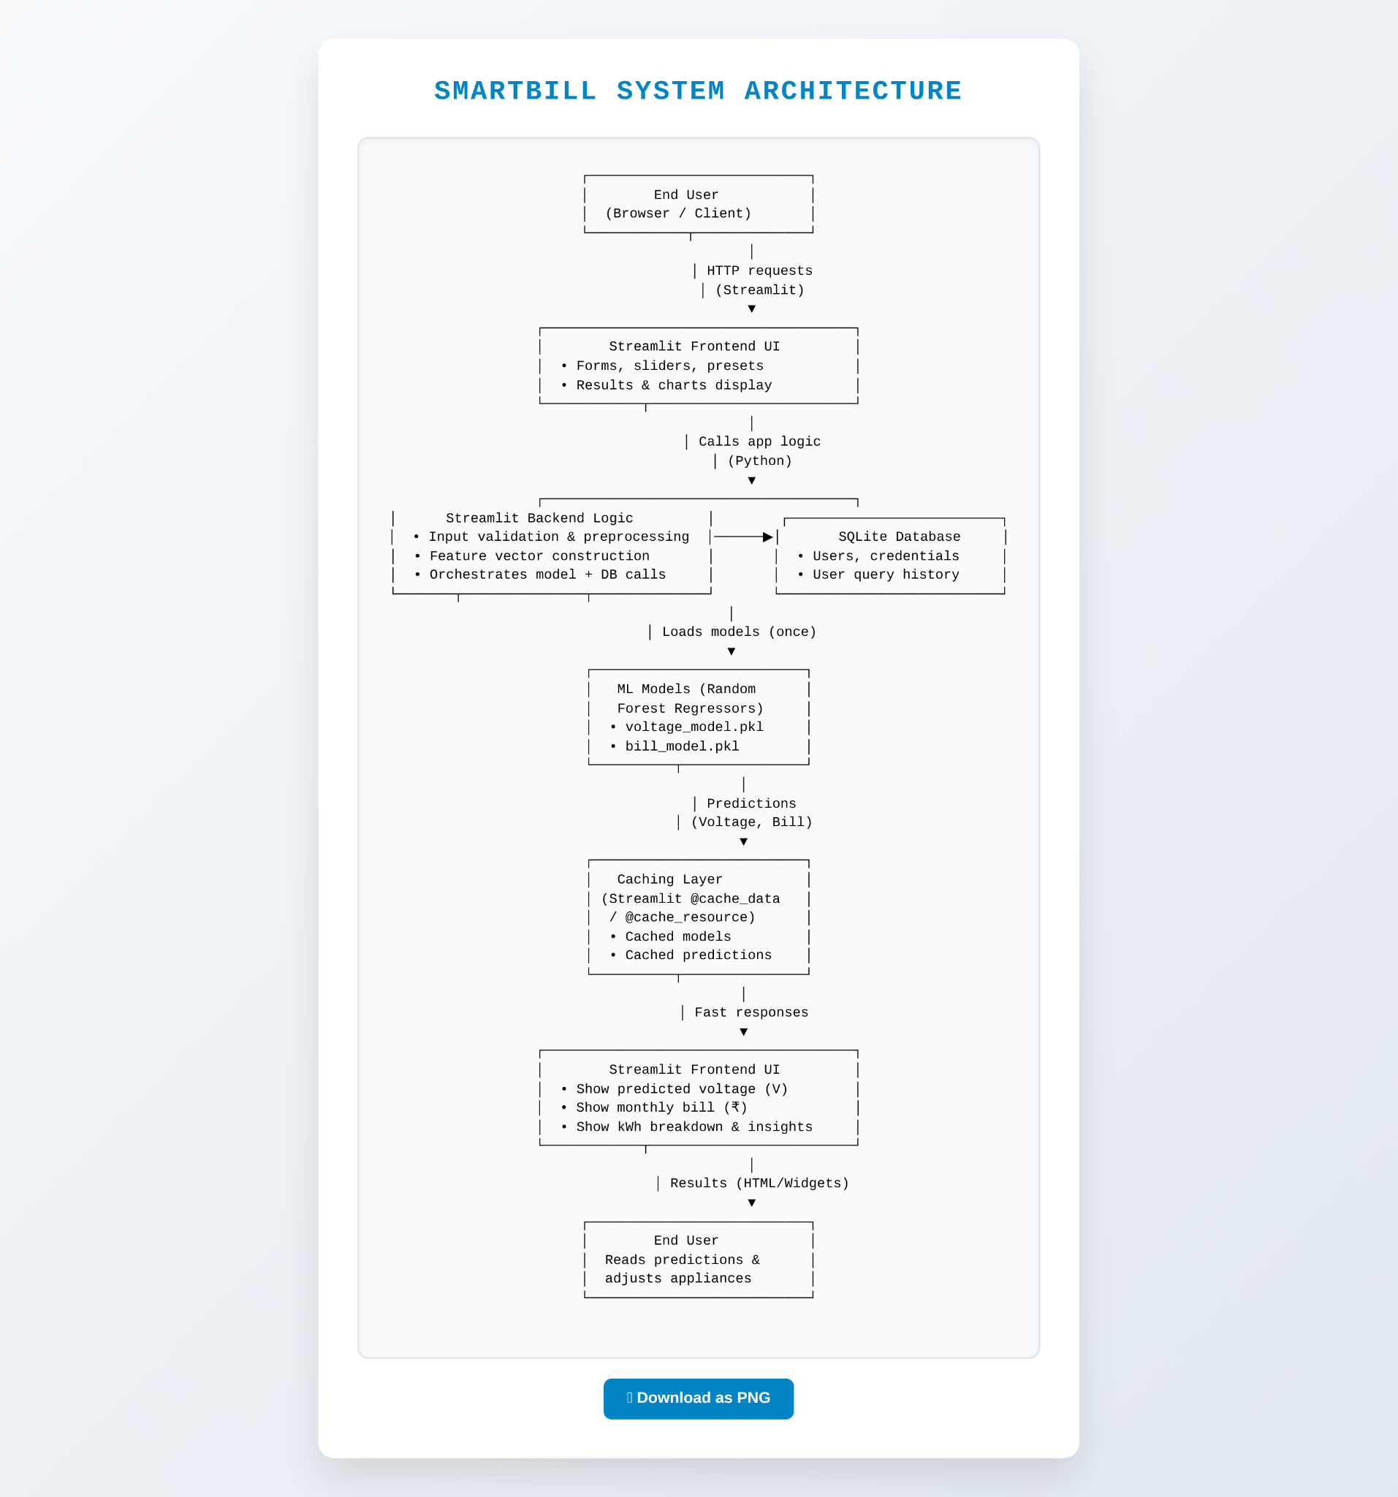
.
.

Slide 7
Machine Learning Model
Algorithm: Random Forest Regressor
• Advantages: Handles non-linear relationships, robust to outliers
• Hyperparameters: 200 estimators, max depth 15, random state 42
• Training Data: 80% (8,000 records)
• Test Data: 20% (2,000 records)

Slide 8
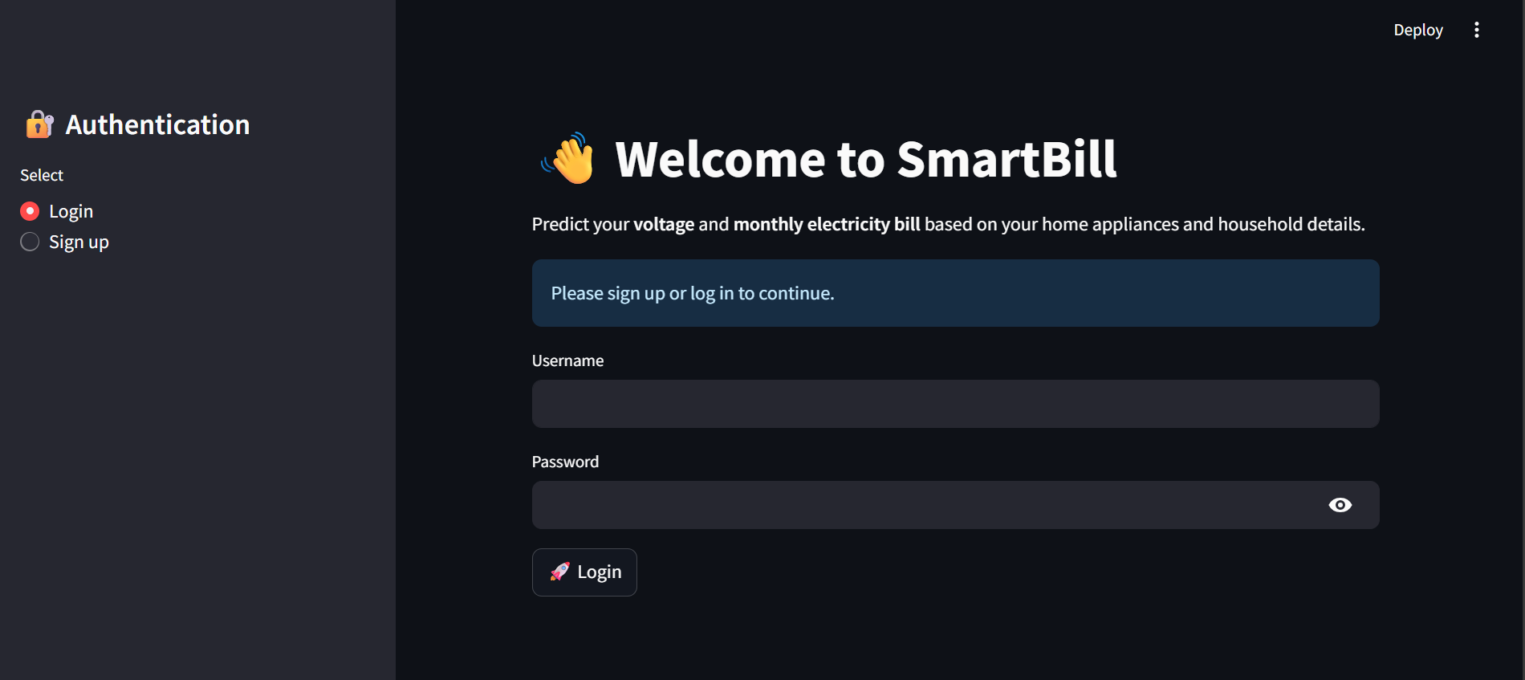
User Interface Demo

Slide 9
Estimated Bill Ranges
• Basic Home (no AC/geyser): ^250-^1,200/month (avg. ^850)
• Middle-Class (1 AC, 1 geyser): ^2,500-^3,500/month (avg. ^2,800)
• Large Family (2+ ACs, geyser): ^3,500-^5,000+/month (avg. ^4,200)

Slide 10
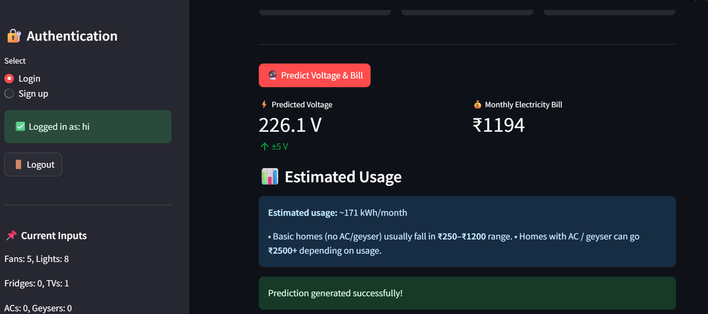
PREDICTED RESULT

Slide 11
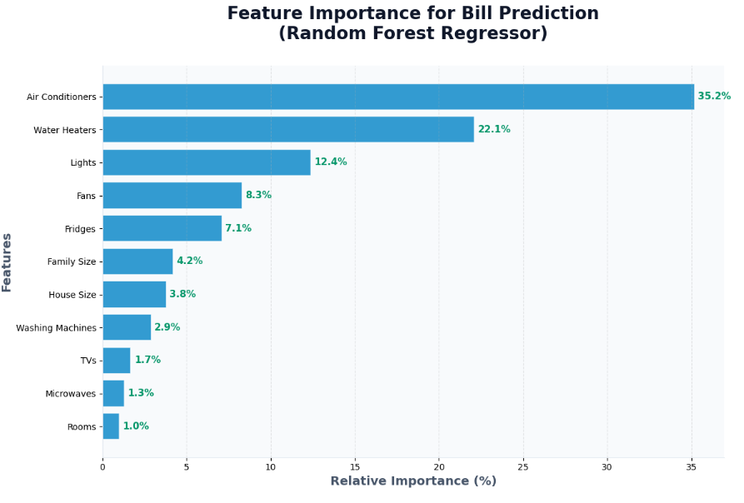

Slide 12
Application Features
• User authentication system with SQLite database backend
• Quick preset scenarios (Basic, Middle-Class, Large Family homes)
• Interactive input forms with real-time validation
• Real-time voltage and bill predictions (<10ms)
• Sidebar summary showing current inputs and last predictions
• Estimated kWh usage and detailed bill breakdown analysis

Slide 13
Technical Stack
Frontend
Streamlit 1.38+
HTML/CSS/JavaScript
Responsive design
ML & Data
scikit-learn 1.5+
pandas, numpy
joblib (model save)
Database & Deployment
SQLite3
Python 3.8+
local serve,
.pkl model files,

Slide 14
Future Enhancements (Roadmap)
• Phase 2: Real smart meter data integration, time-series forecasting, multi-tariff support
• Phase 3: loT integration, regional tariff variations, solar panel predictions
• Phase 4: Mobile app for iOS/Android, API development, cloud deployment (AWS/Heroku)
• Phase 5: EV charger impact analysis, household energy optimization recommendations

Slide 15
Key Takeaways
• Machine Learning can accurately predict household electricity costs (R² = 0.993)
• Random Forest provides superior performance for non-linear relationships
• User-friendly Streamlit interface makes predictions accessible to non-technical users
• Production-grade code with proper caching, authentication, and error handling
• Scalable framework ready for real-world deployment with actual meter data

Slide 16
REFERENCES
Scikit-learn: Random Forest Regressor Documentation
https://scikit-learn.org/stable/modules/generated/sklearn.ensemble.RandomForestRegressor.html
Streamlit Architecture & Client-Server Model
https://docs.streamlit.io/develop/concepts/architecture/architecture
Model Evaluation Metrics: R², RMSE,MAE
https://scikit-learn.org/stable/modules/model_evaluation.html
Deploying ML Models with Python & Streamlit
https://365datascience.com/tutorials/machine-learning-tutorials/how-to-deploy-machine-learning-models-with-python-and-streamlit/

Slide 17
THANK YOU
.

